Slide 1

Web Application Development
COMP-229
Fall 2023

Slide 2
React State Management Overview
React state management is a process for managing the data that React components need in order to render themselves. This data is typically stored in the component's state object. When the state object changes, the component will re-render itself.
React state management is basically half of a React app. It includes all the data. The other half is the presentation including the HTML, CSS, and formatting. State and state management is relied on by presentation part of the app. The only time a React app will re-rendered is when state changes.
React components have a built-in state object. The state is encapsulated data where you store assets that are persistent between component renderings.

Slide 3
The state is just a fancy term for a JavaScript data structure. If a user changes state by interacting with your application, the UI may look completely different afterwards, because it's represented by this new state rather than the old state.

Slide 4
Why do you need React state management?
React applications are built using components and they manage their state internally and it works well for applications with few components, but when the application grows bigger, the complexity of managing states shared across components becomes difficult.
Here is a simple example of an e-commerce application, in which the status of multiple components will change when purchasing a product.
•Add that product to the shopping list
•Add product to customer history
•trigger count of purchased products

Slide 5
If developers do not have scalability in mind then it is really hard to find out what is happening when something goes wrong. This is why you need state management in your application.

Slide 6
React State Management
When it comes to React applications, state is an integral part of what makes the application dynamic and interactive. Without state, applications would be static and unresponsive to user input.
State management is the process of handling the state of an application optimally. It is a crucial part of the development process. In this article, we will take a look at the different state management options available for React developers
and how to choose the right one for your project.

Slide 7
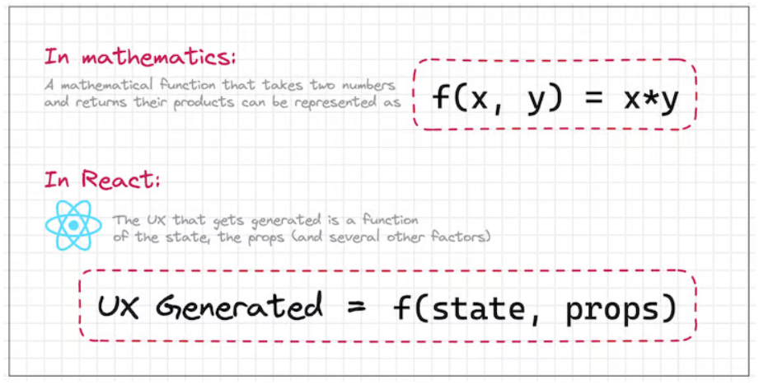
State in React
The UI that is generated in a React app is a function of the state. To invoke reactivity in an app, all we need to do is modify the state, and the React library will take care of the rest. The graphic below sums up the relationship between the application UX, state, and props in React:

Slide 8
React’s built-in state management
React has a variety of built-in features for state management, including the useState and useReducer Hooks, as well as the Context API.
The useState and useReducer Hooks
Both the useState and useReducer Hooks have a different approach for how the state is updated.
Both of these interfaces help us modify state.
React takes care of all the heavy lifting required to faithfully represent that state on the browser DOM.

Slide 9
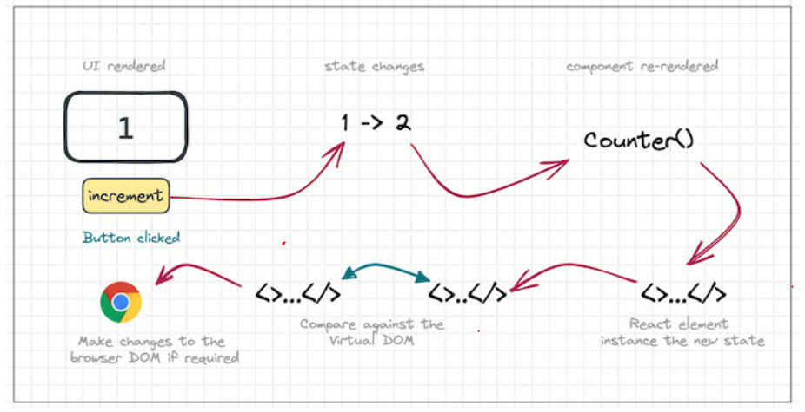
The graphic below sums it up well:

Slide 10
The useState Hook
The useState Hook is the most basic API provided by React to interact with state.
useState is React Hook that allows you to add state to a functional component.
It returns an array with two values: the current state and a function to update it.
The Hook takes an initial state value as an argument and returns an updated state value whenever the setter function is called.
It can be used like this:
const [state, setState] = useState(initialValue);
Here, the initialValue is the value you want to start with,
and state is the current state value that can be used in your component.
The setState function can be used to update the state, triggering a re-render of your component.

Slide 11
Using the portfolio app created in your Assignment1
In the src folder create a file called counter.jsx

Slide 12
Src/counter.jsx
EXAMPE 1
let’s create the state:
const [count, setCount] = useState(0);
The above piece of code creates a state variable called count and a function called setCount that can be used to update the state. The initial value of the state is set to 0.
Now, we’ll update the state by incrementing the value of count by 1:
setCount(count + 1);
Finally, we’ll use the state:
<p>You clicked {count} times</p>

Slide 13
Updated src/counter.jsx
import React, { useState } from 'react';
function Counter() {
const [count, setCount] = useState(0);
const handleIncrement = () => {
setCount(count + 1);
};
return (
<div>
<p>You clicked {count} times</p>
<button onClick={handleIncrement}>Click me</button>
</div>
);
}
export default Counter;

Slide 14
Client/MainRouter.jsx
Import the component Use and create a route for it in the MainRouter.jsx as follows:
import Counter from './src/counter’
.
.
.
<Route exact path="/counter" element={<Counter />} />

Slide 15
Updated MainRouter.jsx
import React from 'react'
import { Route, Routes } from 'react-router-dom'
import Home from './components/Home'
import About from './src/about'
import Contact from './src/contact'
import Education from './src/education'
import Project from './src/project'
import Counter from './src/counter'
import Layout from './components/layout'
const MainRouter = () => {
return (<div>
<Layout/>
<Routes>
<Route exact path="/" element={<Home />} />
<Route exact path="/about" element={<About />} />
<Route exact path="/education" element={<Education />} />
<Route exact path="/project" element={<Project />} />
<Route exact path="/contact" element={<Contact />} />
<Route exact path="/counter" element={<Counter />} />
</Routes>
</div>
)
}
export default MainRouter

Slide 16
Client/components/layout.jsx
Create a link to the counter.jsx in the layout.jsx
<Link to="/">Home</Link> | <Link to="/about">About</Link> | <Link to="/education">Education</Link>| <Link to="/project">Project</Link>| <Link to="/contact">Contact</Link> | <Link to="/counter">Counter</Link>

Slide 17
Updated layout.jsx
import React from 'react';
import { Link } from 'react-router-dom';
import football1 from '../src/assets/football1.jfif';
export default function Layout() {
return (
<>
< img src={football1}alt="football" className="football" width="50px" height="50px"/>
<h1>My Portfolio</h1>
<nav>
<Link to="/">Home</Link> | <Link to="/about">About</Link> | <Link to="/education">Education</Link>| <Link to="/project">Project</Link>| <Link to="/contact">Contact</Link> | <Link to="/counter">Counter</Link>
</nav>
<br/>
<hr />
</>
);
}

Slide 18
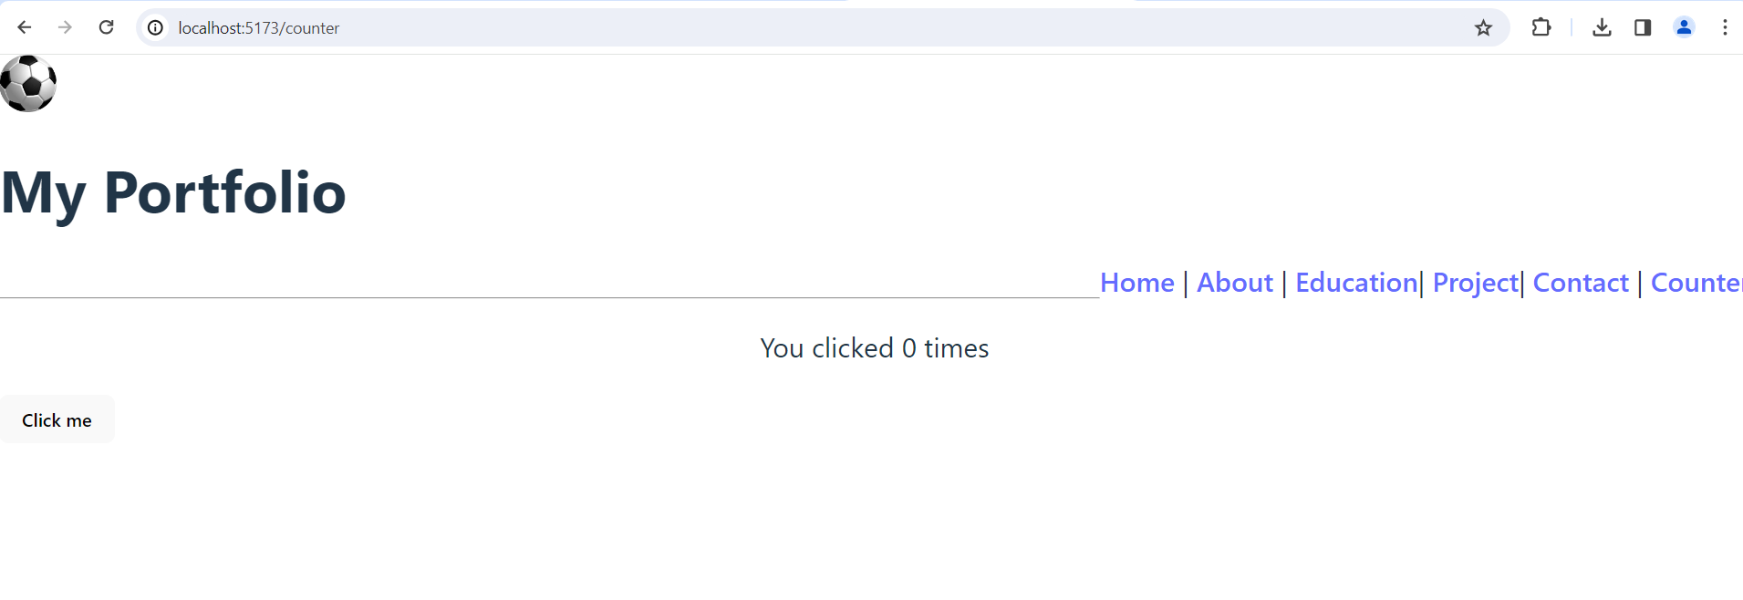
In this example, we used the state by displaying the value of count in the UI.
Run the app using this command:
Yarn dev or npm run dev

Slide 19
The useReducer Hook
The useReducer Hook allows us to manage state by dispatching actions and then responding to them in the reducer function.
Again, we’ll use a counter app example to understand how this hook works:
const [state, dispatch] = useReducer(reducerFunc, 0);
We call the useReducer Hook with the reducer function and the initial state as arguments.
It returns the current state and a dispatch function. Whenever we need to update the state, we can call the dispatch function with an action object:
dispatch({ type: 'INCREMENT' })

Slide 20
React then calls the reducer function with the action object. Here’s what a common reducer function looks like:
function reducerFunc(state, action) {
switch (action.type) {
case 'INCREMENT’:
return state + 1;
case 'DECREMENT’:
return state - 1;
case 'RESET’:
return 0;
case 'SET’:
return action.val;
}
}

Slide 21
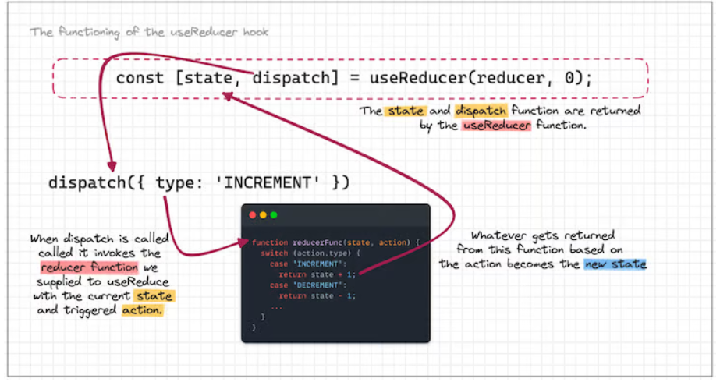
At the end of this transaction, whatever the reducer function returns becomes the new state and is accessible through the state variable.
Here’s a sketch that explains the flow of data in the useReducer Hook:

Slide 22
At the terminal import reactDom with any of the following command:
yarn add react react-dom
OR
npm install react react-dom

Slide 23
Updated src/counter.jsx
import React, { useReducer } from 'react';
// Define a reducer function
const reducer = (state, action) => {
switch (action.type) {
case 'INCREMENT':
return { count: state.count + 1 };
case 'DECREMENT':
return { count: state.count - 1 };
default:
return state;
}
};
function Counter() {
// Initialize state using useReducer
const [state, dispatch] = useReducer(reducer, { count: 0 });
return (
<div>
<p>Count: {state.count}</p>
<button onClick={() => dispatch({ type: 'INCREMENT' })}>Increment</button>
<button onClick={() => dispatch({ type: 'DECREMENT' })}>Decrement</button>
</div>
);
}
export default Counter;

Slide 24
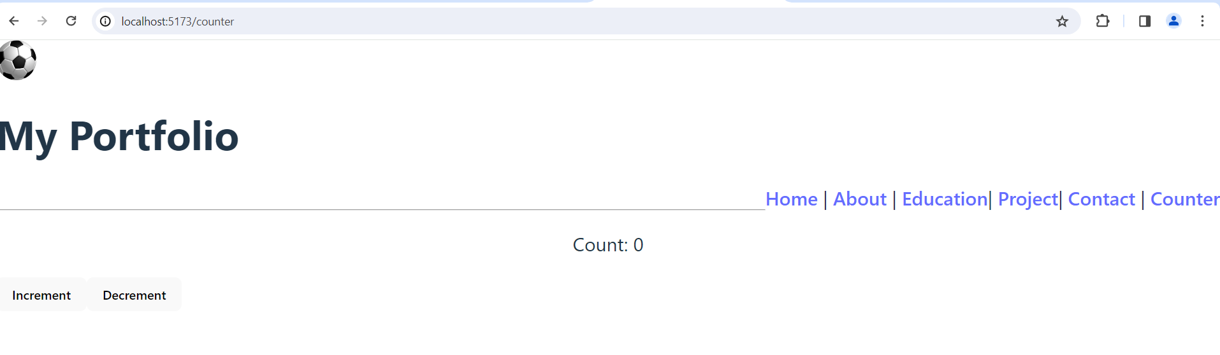
Run the app using:
Yarn dev or npm run dev

Slide 25
Third-party libraries for state management
Alternatives​
If neither of the above built-in strategies work for your specific application, don't worry; there exist many 3rd party alternatives. Some of the more popular state management libraries include:
Redux / Redux Toolkit: "The official, opinionated, batteries-included toolset for efficient Redux development. Includes utilities to simplify common use cases like store setup, creating reducers, immutable update logic, and more."
Recoil: "A state management library for React. Recoil works and thinks like React. Add some to your app and get fast and flexible shared state."

Slide 26
Jotai: "Jotai takes a bottom-up approach to React state management with an atomic model inspired by Recoil. One can build state by combining atoms and renders are optimized based on atom dependency. This solves the extra re-render issue of React context and eliminates the need for the memoization technique."
Zustand: "A small, fast and scalable bearbones state-management solution. Has a comfy api based on hooks, isn't boilerplatey or opinionated, but still just enough to be explicit and flux-like."

Slide 27
MobX: "MobX is a battle tested library that makes state management simple and scalable by transparently applying functional reactive programming (TFRP)."
HookState: "The most straightforward, extensible and incredibly fast state management that is based on React state hook"

Slide 28
STAR RATING APP

Slide 29
Building a Star Rating Component
The StarRating component will allow users to rate content based on a specific number of stars.
Content that is no good gets one star. Highly-recommended content gets 5 stars.
Users can set the rating for specific content by clicking on a specific star.
First, we’ll need a star and we can get one from react-icons:
At the root i.e terminal
npm i react-icons

Slide 30
react-icons is a npm library that contains hundreds of svg icons that are distributed as React components.
By installing it, we just installed several popular icon libraries that contain hundreds of common SVG icons.
You can browse all of the icons at https://react icons.netlify.com.
We are going to use the star icon from the font awesome collection.

Slide 31
Updated src/counter.jsx
import React, { useState } from "react";
import { FaStar } from "react-icons/fa";
export default function StarRating({ totalStars = 5 }) {
const [selectedStars, setSelectedStars] = useState(0);
const createArray = (length) => {
return Array.from({ length }, (_, index) => index);
};
return (
<>
{createArray(totalStars).map((n, i) => (
<Star
key={i}
selected={selectedStars > i}
onSelect={() => setSelectedStars(i + 1)}
/>
))}
<p>
{selectedStars} of {totalStars} stars
</p>
</>
);
}
const Star = ({ selected = false, onSelect }) => (
<FaStar color={selected ? "red" : "grey"} onClick={onSelect} />
);

Slide 32
